Slide 1



Cyber Patriot XVI
Deb Minassian Coach and mentor

Slide 2
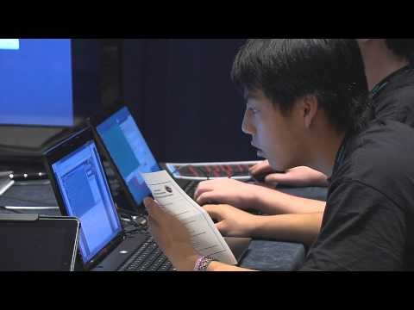
What is Cyber Patriot?

Slide 3
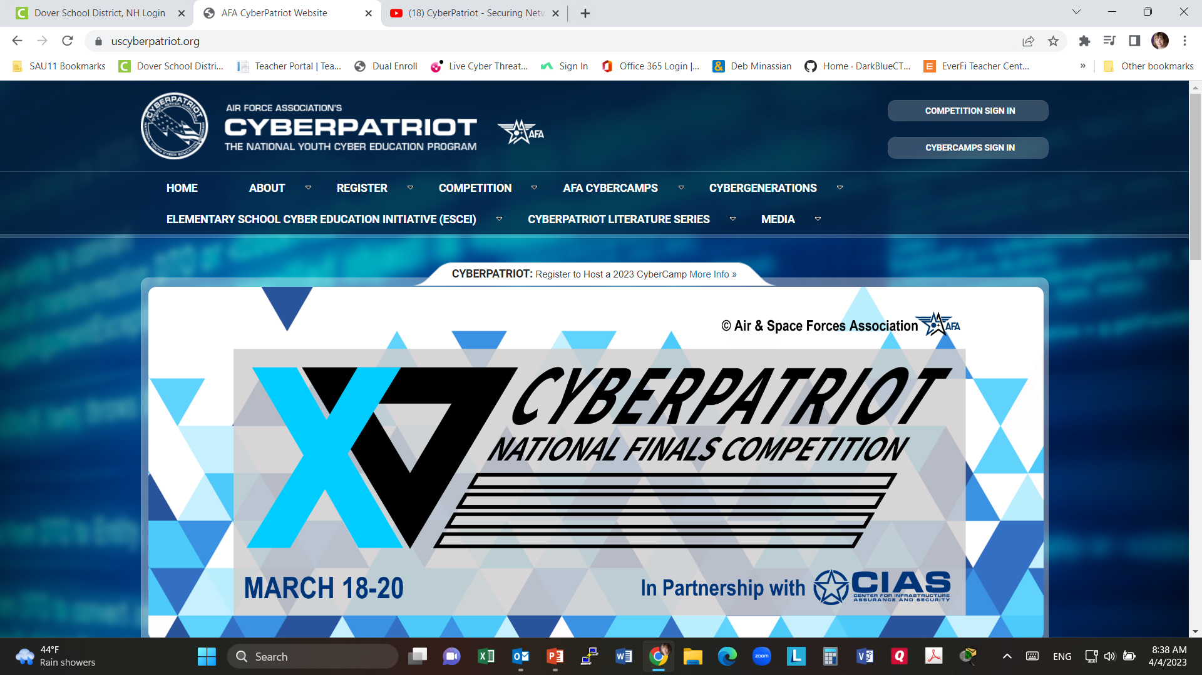
Uscyberpatriot.org

Slide 4
competition
Getting Started
New Coach Resources
Current Competition
History
Rules Book
Technical Specifications
Training Materials

Slide 5
Getting Started
Competition Overview
Coach – The administrative lead of the team. Main point of contact. Each team can have one coach.
Competitors – A team consisting of a minimum of 2 and up to 6 students. Six students are permitted on each team's roster, a maximum of five students are permitted to compete at any one time during a competition round. A one-time substitution can be made each round.
Technical mentors - IT​​-experienced individuals who volunteer to assist in the cybersecurity training of CyberPatriot teams. Mentors must register on the CyberPatriot website and are required to successfully complete a background check before being eligible to officially join a team. (Minimum age: 18)
Team Assistants - Adult volunteers who provide non-technical support and encouragement to the team (assisting with scheduling, set-up, snacks, etc.). Team assistants must register on the CyberPatriot website and pass a background check. (Minimum age: 18)

Slide 6
Divisions
Based on the competitor composition, a team is assigned to one of three divisions:
Open Division: High school students from schools, scouting units, Boys and Girls Clubs, home school programs, STEM programs, etc.
All Service Division: High school students in JROTC Programs / Civil Air Patrol units / Naval Sea Cadet Corps units
Middle School Division: Middle school students from schools, scouting units, boys and girls clubs, STEM programs, etc.

Slide 7
How?
CyberPatriot is designed for any student, regardless of prior cybersecurity knowledge. Training materials are available through the volunteer dashboard and through Cisco Networking Academy. Instructions for competition round preparation are emailed directly to coaches prior to each round.
CLICK HERE for a general overview of how to prepare for a round
CLICK HERE for an in-depth explanation of how the competition works
CLICK HERE for a full list of competition hardware and software requirements
CLICK HERE for the full competition rules book

